Slide 1

COMP 499/691: Conversational Artificial Intelligence
Self-Supervised Speech Features
Computer Science & Software Engineering
Concordia University, Winter 2024

Slide 2
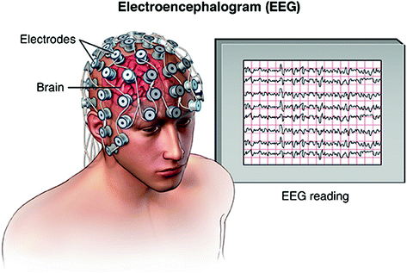

Seminar
Date | Room | Lecture topics
Feb., 16 9 am - 11 am | Remote | Introduction to EEG and EEG decoding
Feb., 23 9 am - 11 am | Remote | EEG Decoding with SpeechBrain
March, 15 9 am - 11 am | Remote | Decoding speech from the EEG
Dr. Davide Borra
University of Bologna
Connect at this zoom link:
https://concordia-ca.zoom.us/j/8734602220

Slide 3


MidTerm Exam and Project
This Friday (March 15) 1.00 pm - 2.30 pm Exam Correction (Remote Meeting)
Connect at this zoom link:
https://concordia-ca.zoom.us/j/8734602220
Start your project now if you haven't already!

Slide 4
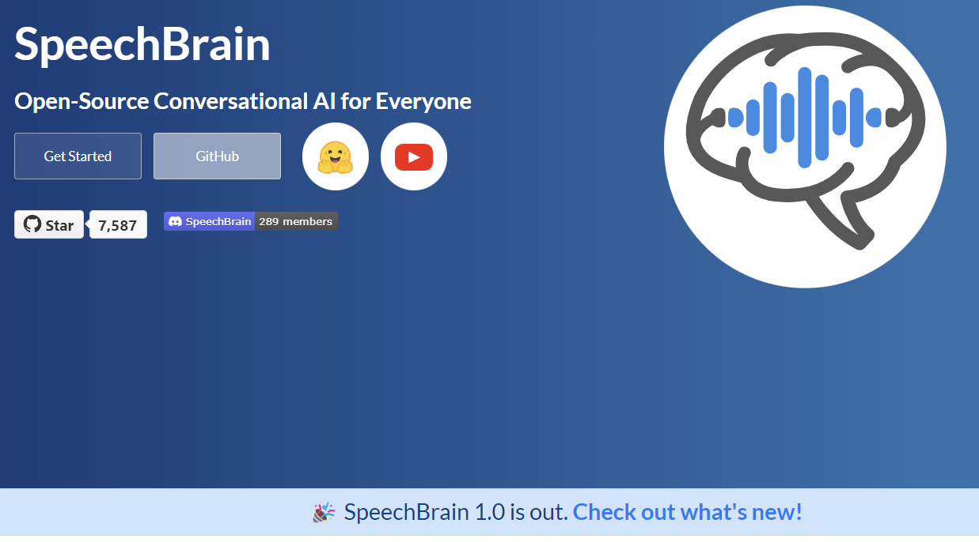
SpeechBrain 1.0
https://speechbrain.github.io/

Slide 5
Summary of the last episode….
What we have seen last time:
Speech Features (Signal Processing)
What we are going to learn today:
Speech Processing from the Raw Waveform
Self-supervised Speech Features (PASE, Wav2Vec, Hubert, WavLM)

Slide 6
Speech Processing from the Raw Waveform

Slide 7
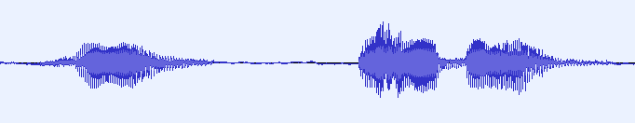
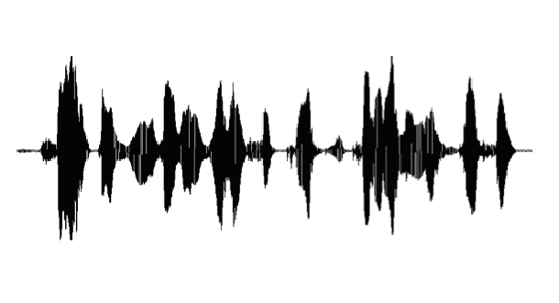
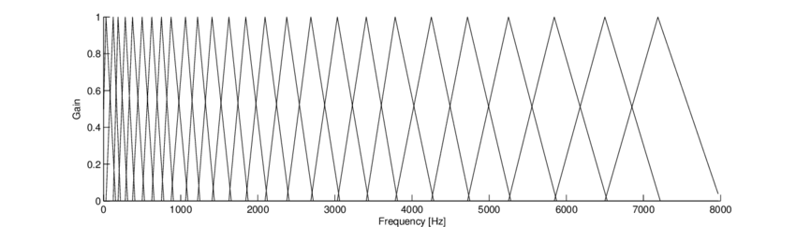
Raw Waveform Speech Processing
In the last lecture, we saw how to extract speech features using signal processing:
Feature Extraction
Raw waveform
Feature vectors
For instance, we have seen how to compute FilterBanks (FBANKs):
STFT
Spectrogram
Mel-Filters
FBANKs
log(ᐧ)
40/80 filters
Window length = 25 ms
Hop length = 10 ms

Slide 8


Raw Waveform Speech Processing
The features are a compact representation of the raw waveform.
We feed them into a neural network that will solve the speech processing task of interest.
Feature Extraction
DNN
Prediction
FBANKs
Can we feed the raw waveform directly into the neural network?
DNN
Prediction

Slide 9
Raw Waveform Speech Processing
We can feed the raw waveform into neural networks.
The potential advantage is that we can learn features specifically tuned to the task of interest.
We need to employ deeper neural networks where the first layers are dedicated to low-level feature extraction.
Low-Level Features
High-Level Features
Raw Waveform
What are the issues?

Slide 10

Raw Waveform Speech Processing
Incorporating additional layers for low-level feature extraction can present a few complications:
Low-Level Features
High-Level Features
The model gets more memory and computational demanding.
Raw Waveform
The raw waveform is high-dimensional.
Processing such a large amount of information is computationally expensive!
Moreover, the early layers added for low-level feature extraction suffer more from vanishing gradients.
This has hindered neural networks from learning features outperforming the standard ones.

Slide 11
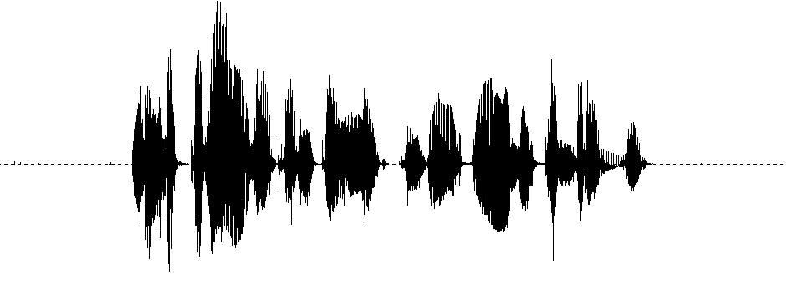
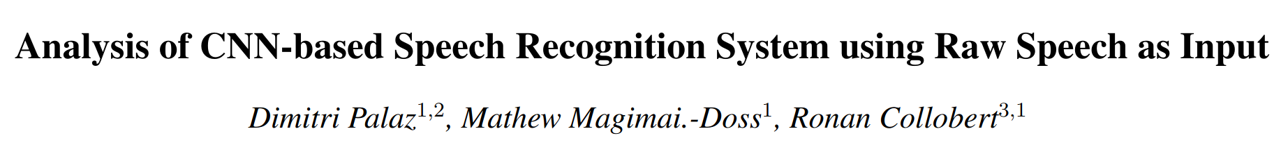
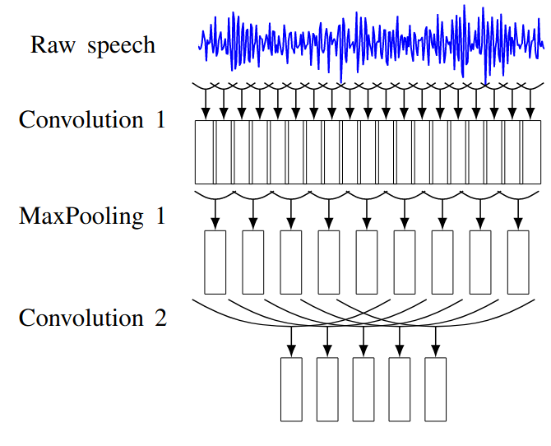
Raw Waveform Speech Processing
A standard approach is to learn low-level features with Convolutional Neural Networks.
See paper here
CNN
DNN
Prediction

Slide 12
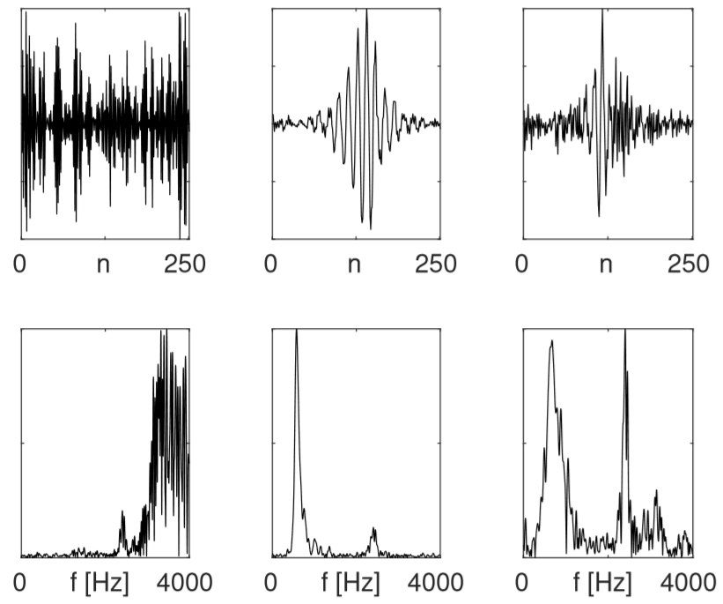
Raw Waveform Speech Processing
A standard approach is to learn low-level features with Convolutional Neural Networks.
We can inspect the filters learned by the first convolutional layer:
The filters are very “noisy.”
CNN
Time-domain
As mentioned before, learning good features is hard.
DNN
Frequency-domain
This model's performance is typically inferior to those achieved with standard features.
Prediction

Slide 13
Raw Waveform Speech Processing
A standard approach is to learn low-level features with Convolutional Neural Networks.
How can we help the CNN to learn better features?
CNN
Time-domain
DNN
Frequency-domain
Prediction

Slide 14

SincNET
A standard approach is to learn low-level features with Convolutional Neural Networks.
How can we help the CNN to learn better features?
CNN
A simple idea:
Inject prior knowledge of the filter shape
DNN
Prediction

Slide 15


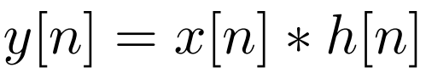
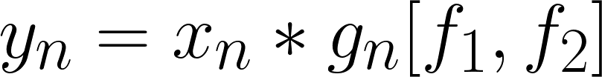

SincNET
Predictions
One idea is to inject prior knowledge on the filter shape.
This is the basic idea behind SincNET.
Neural Network
It replaces a standard convolution with a sinc-based one (sinconv).
yn
Standard Convolution
SincConv
…..
Sinc Filters
…..
…..
…..
fn
We parametrize the kernel such that we learn rectangular band-pass filters whose cut-off frequencies can be tuned.

Slide 16
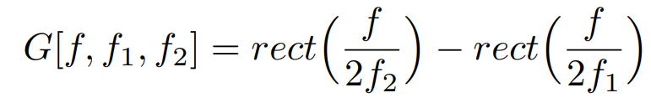
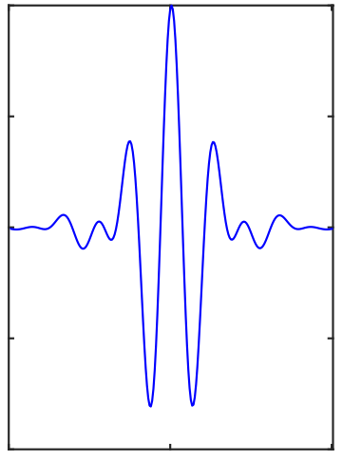
SincNET
Predictions
Standard Convolution
SincConv
Neural Network
yn
Frequency Domain
Time Domain
…..
Sinc Filters
…..
…..
…..
fn
f1
Freq[Hz]
f2

Slide 17
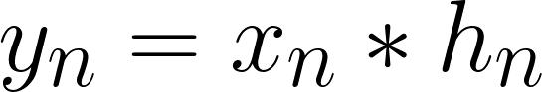
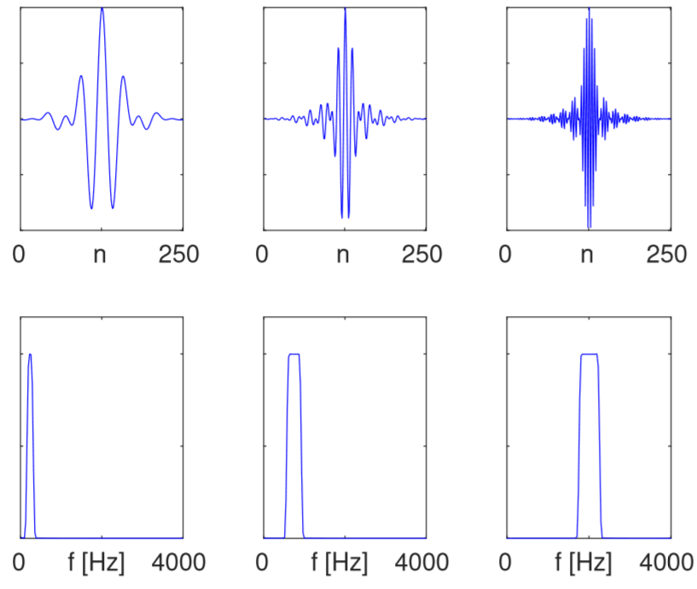

SincNET
Standard Convolution
SincConv
We learn L parameters for each filter.
For each filter, we only learn 2 parameters (f1 and f2).
Advantages:
Fewer Parameters
Better Performance
Interpretability
M. Ravanelli, Y. Bengio, "Speaker Recognition from raw waveform with SincNet", in Proc. of SLT 2018.

Slide 18
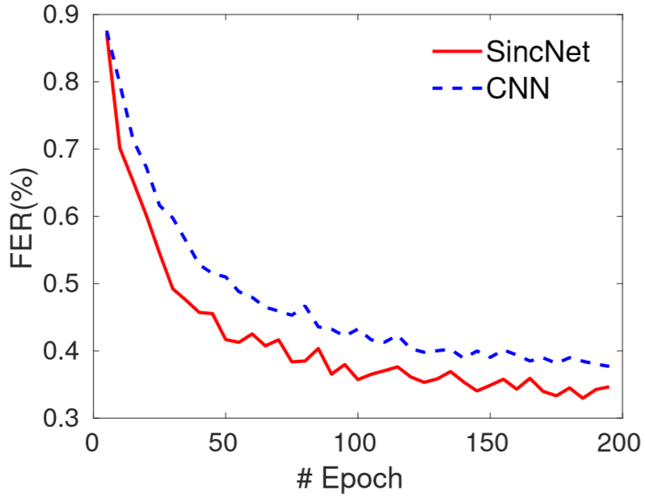
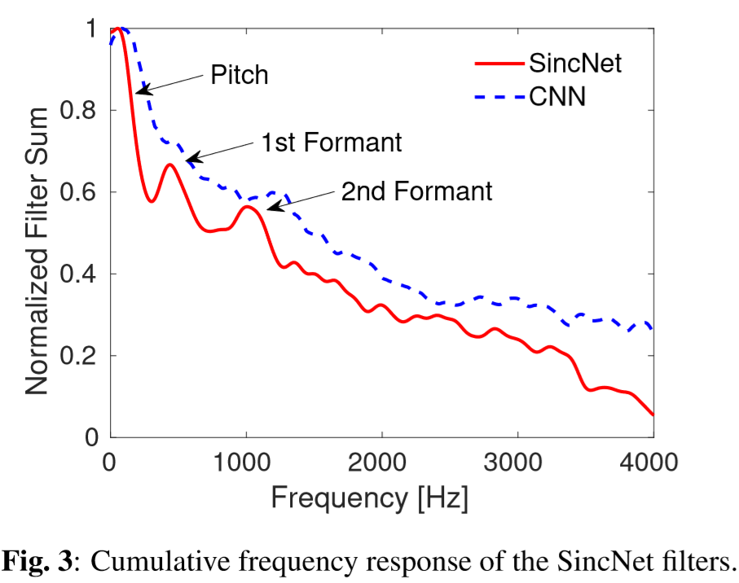
SincNET
Predictions
Some results on speaker recognition:
Training Curve
Filter Distribution
Neural Network
yn
…..
Sinc Filters
…..
…..
…..
fn
M. Ravanelli, Y. Bengio, "Speaker Recognition from raw waveform with SincNet", in Proc. of SLT 2018.

Slide 19
Raw Waveform Speech Processing
Feeding raw speech waveforms to neural networks is becoming more common.
This practice leads to better results when we have large datasets and enough computing power (which is common these days).
Beyond SincNet, there are many other examples of models trained on top of waveforms:
ConvTasnet
Dual-Path RNNs
SepFormer
….
Speech Separation/Enhancement
WaveNet
Generative Models
SampleRNN
….

Slide 20
Self-supervised Speech Features

Slide 21
Self-supervised Speech Features
Learning robust and general speech features with neural networks is challenging.
Low-Level Features
High-Level Features
Raw Waveform
We need a huge dataset to learn high-quality features.
So far, we learned these features with supervised learning.
What are its limitations?
Data annotation is expensive, time-consuming, and requires humans in the loop.
Issues:
Supervised features are biased toward a specific task.

Slide 22
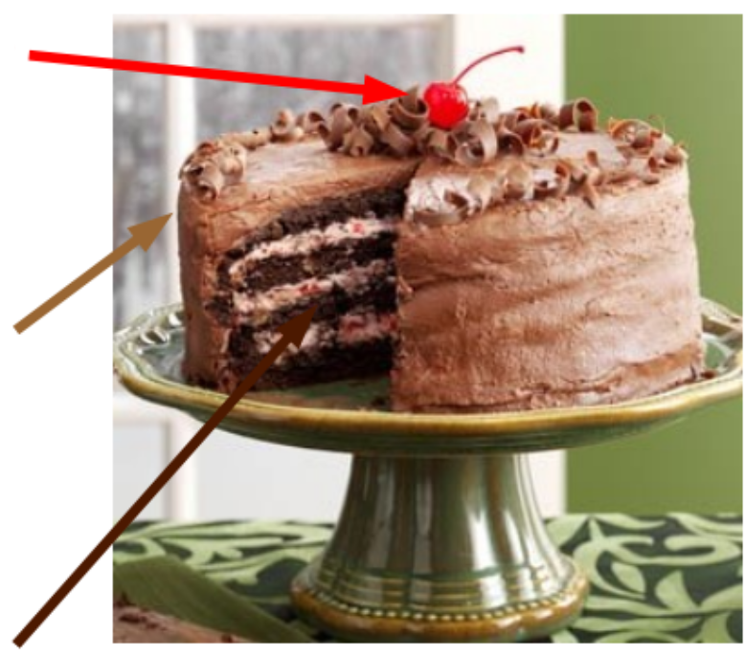
Self-supervised Speech Features
Can we learn features using unlabelled data?
This is the goal of unsupervised learning.
Reinforcement Learning
Unsupervised Learning
=
Learning Without a Teacher
Supervised Learning
Unsupervised Learning
Humans and animals learn important information about the world simply through observation.

Slide 23

Self-supervised Speech Features
What are the potential advantages?
We can use very large unlabelled datasets.
We can potentially learn robust features, that are general enough for many speech processing tasks.
If we can learn general features, the speech processing models can be trained on a smaller labeled dataset.
That looks promising, but….
How can we define meaningful objective functions if we do not have the labels?

Slide 24


Self-supervised Speech Features
A possible solution is to extract labels from the signal itself.
This is what is done in the context of self-supervised learning.
Self-supervised Learning = the label is extracted from the signal itself.
Crazy, but effective idea!
Often, we apply known transforms to the input data and use the resulting outcomes as targets.
Even though we use a label, self-supervised learning falls under the category of unsupervised learning because we obtain the label without the need for any human intervention.

Slide 25
Self-supervised Speech Features
Self-supervised learning systems often have the following components:
Label
Extraction
Encoder
Pretext model
L
Encoder: it is a neural network converting the raw signal into higher-level features.
Label extraction: we define a pretext task and we extract labels from the input signal itself.
Pretext model: it is a neural network solving the pretext task.
Loss: it measures the difference between the prediction of the pretext model and the labels. As in supervised learning, we train the model (encoder+pretext) to minimize it.

Slide 26
Self-supervised Speech Features
Self-supervised training
Label
Extraction
Encoder
Pretext model
L
Supervised fine-training
Encoder
Classifier
L
Label
After training the model through self-supervised learning, we attach a classifier on top of the encoder.
We then fine-tune both the encoder and classifier using a (small) supervised dataset to perform a specific downstream task.

Slide 27
Self-supervised Speech Features
An autoencoder is the simplest type of self-supervised model.
Convolutional Encoder
Convolutional Decoder
Bottleneck
The encoder transforms the input signal into a compact set of features.
The pretext task consists of reconstructing the original signal from the encoded features.
Introducing a bottleneck is necessary to ensure a meaningful pretext task. Without it, the network may learn a trivial identity mapping.
We can use Mean Squared Error as a loss.

Slide 28
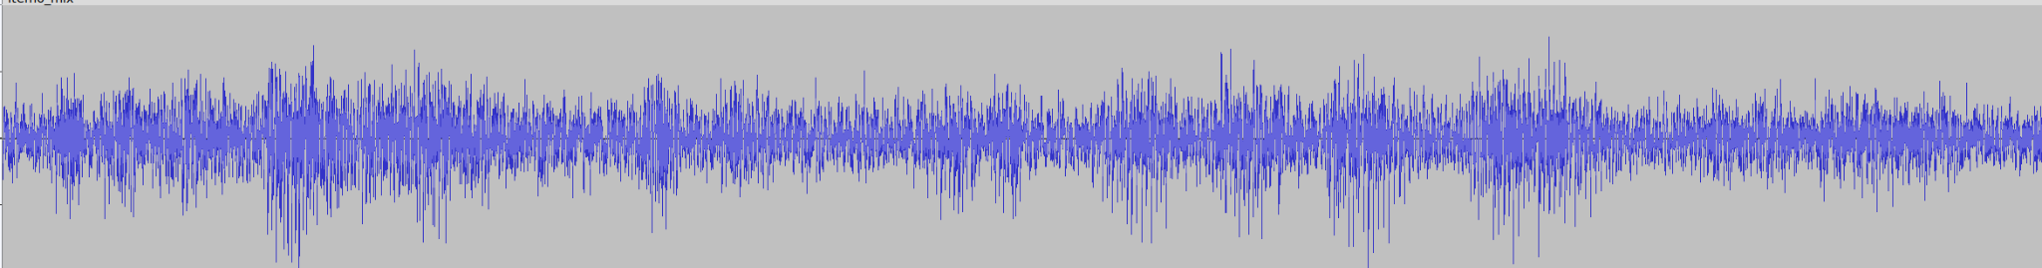
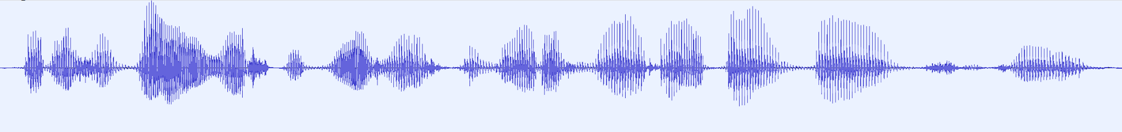
Self-supervised Speech Features
To increase the difficulty of the pretext task, we can corrupt the input signals and predict the original clean signal in the output.
We can contaminate the input signal in different ways:
Add noise
Inject reverberation
Add chunks of zeros in the waveform
We can zero out certain frequency bands by applying random band-pass filters
…….
Denoising autoencoder
Convolutional Encoder
Convolutional Decoder
Bottleneck

Slide 29
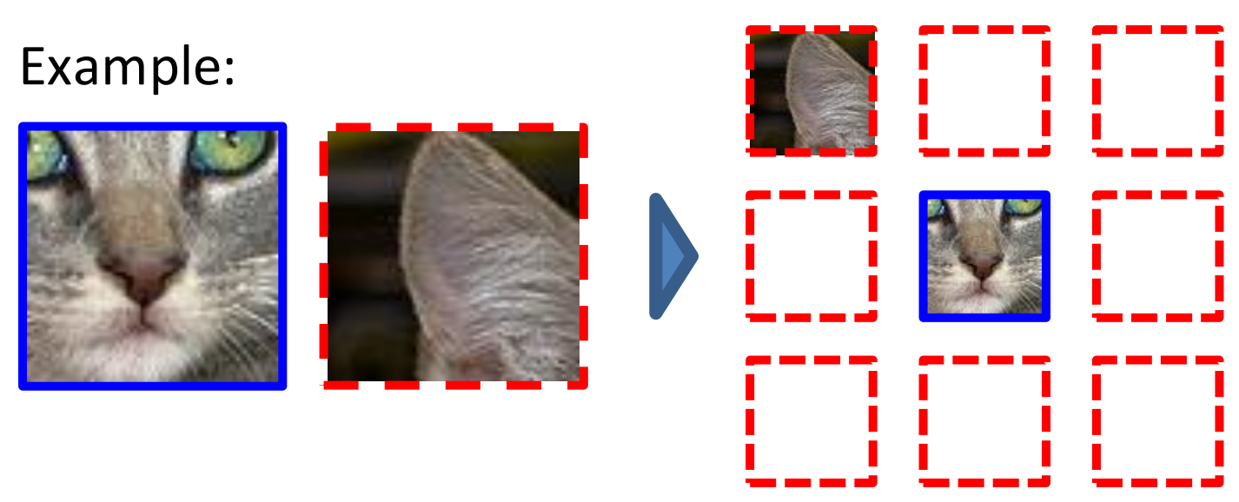
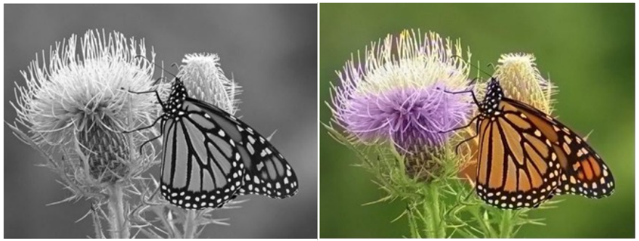
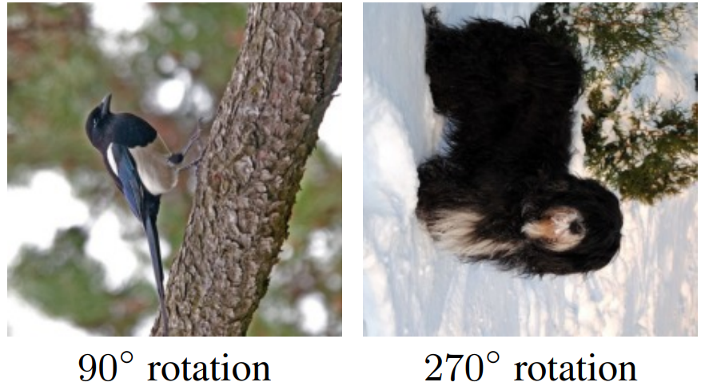
Self-supervised Speech Features
Beyond autoencoders, we can think about many other pretext tasks.
Defining meaningful pretext tasks is a crucial part of self-supervised learning.
The initial breakthroughs in self-supervised learning occurred in the field of computer vision.
Researchers were able to learn robust, general, and abstract features by solving tasks like:
Relative Positioning
Colorization
Correct Rotation
(Doersch et. al. , ICCV 2015)
(Zhang et al., ECCV 2016)
(Gidaris et al., ICLR 2018)

Slide 30
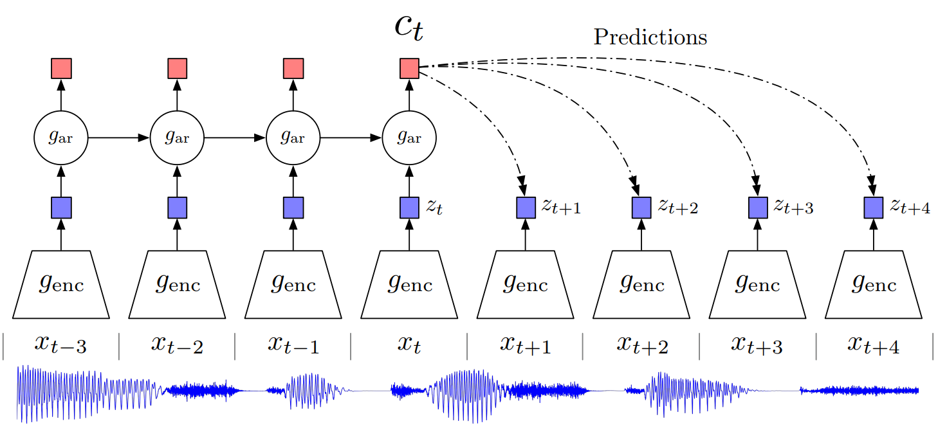
Contrastive Predicting Coding
Shortly thereafter, researchers began exploring the use of self-supervised learning for audio and speech.
One of the first successful methods was called “Contrastive Predicting Coding” (CPC)
In CPC the pretext task consists to predict the future given the past.
This task encourages the encoder to learn high-level long-term features from the input signal.
(Van den Oord et al., 2018)

Slide 31

Contrastive Predicting Coding
First, an encoder maps the input speech chunks xt to a sequence of latent representations zt.
Next, an autoregressive model gar summarizes all previous representations into a context vector ct.
(Van den Oord et al., 2018)
CPC does not predict the future z directly, but rather uses contrastive learning.
In contrastive learning, a neural network is presented with pairs of positive and negative samples, and it is trained to distinguish between them.
Positive samples: the right future elements z
In this case:
Negative samples: the wrong future elements z

Slide 32
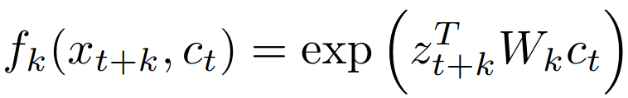
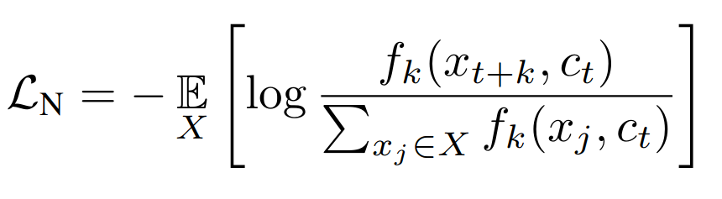
Contrastive Predicting Coding
CPC is trained in this way:
score
score
score
score
Neural Network
Neural Network
Neural Network
Neural Network
zt+1
Ct
z1
Ct
z2
Ct
z3
Ct
(Van den Oord et al., 2018)
Positive Sample (right future element)
Negative Samples (wrong future element)
The neural network that computes the score is:
The loss (called InfoNCE Loss ) to optimize is:
Score of the positive sample
Sum of the scores of the negative samples.
Intuition: the loss function is lower when the score associated with positive samples is greater than that of negative samples.

Slide 33
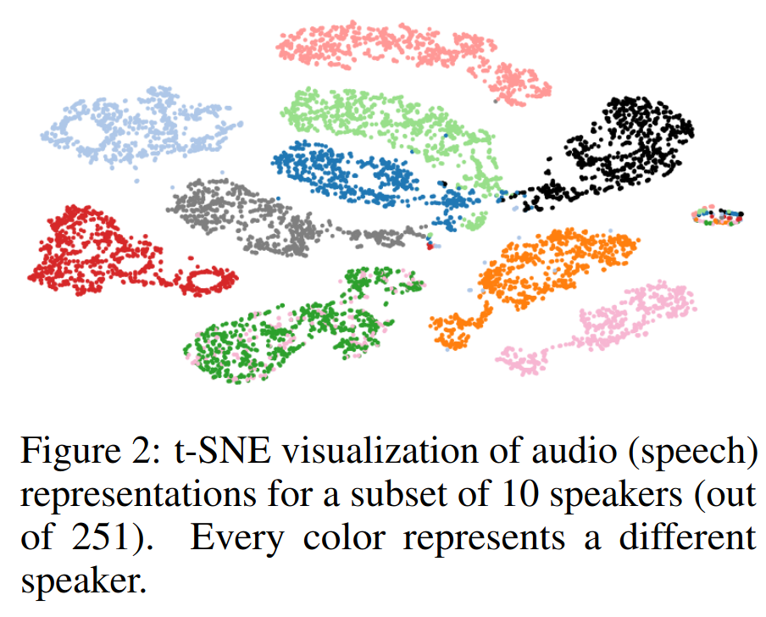
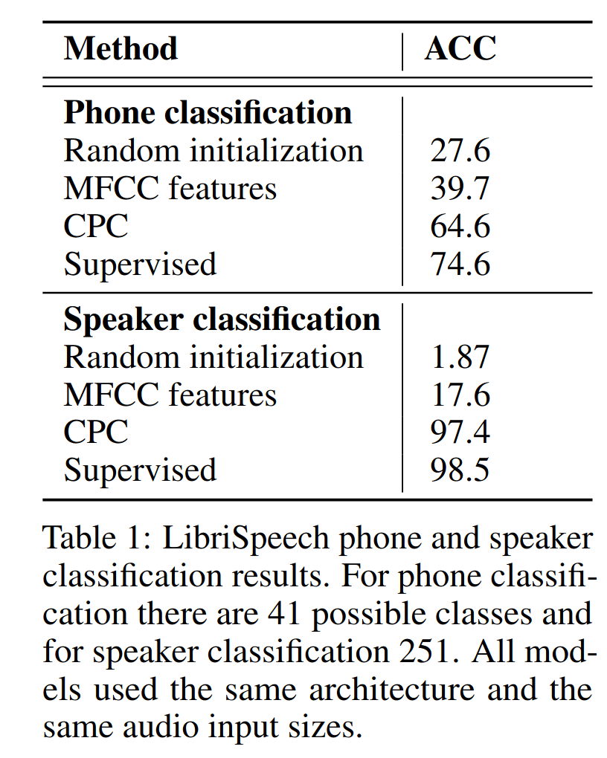
Contrastive Predicting Coding
With CPC we can learn features that outperform traditional ones:

Slide 34
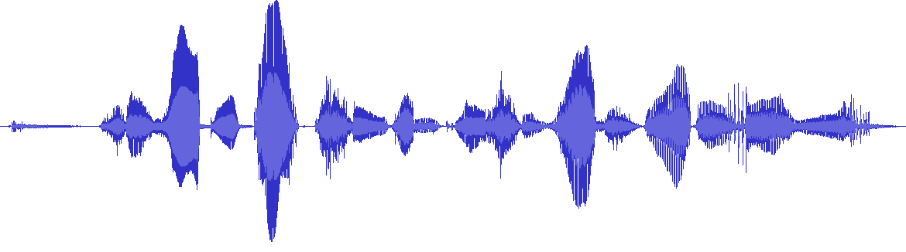
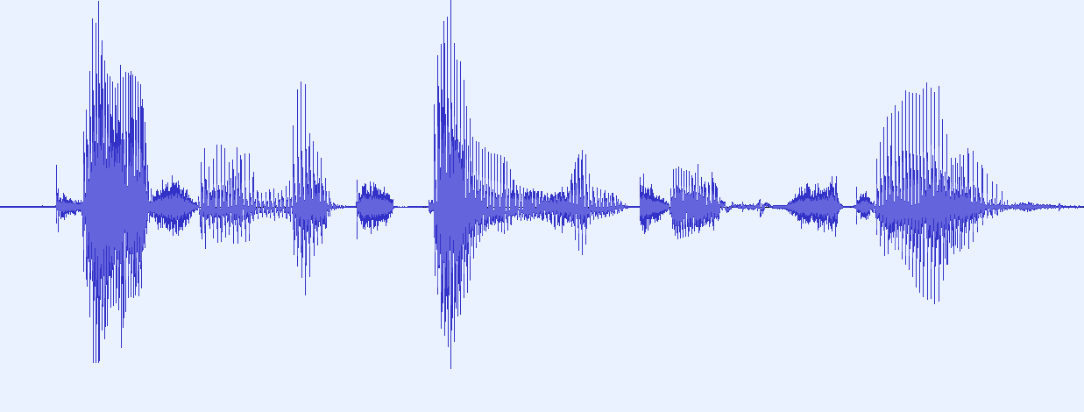
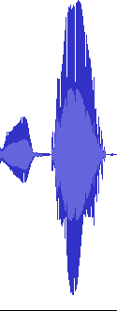
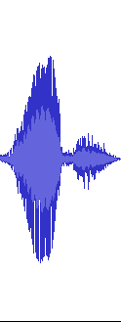
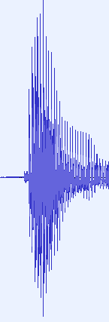
Local Info Max
An alternative to CPC is Local Info Max (LIM).
Similar to CPC, LIM employs a neural encoder that converts a chunk of speech into a higher-level latent representation.
c1
c2
crnd
LIM relies on a standard binary discriminator (trained with binary cross-entropy).
c1
Encoder
fθ
z1
Discrim.
gφ
The pretext task in contrastive learning is not focused on predicting the future.
c2
Encoder
fθ
z2
crnd
Encoder
fθ
zrnd
Instead, the goal is to determine whether two randomly selected chunks of data come from the same speech recording or not.
(Ravanelli, 2019)

Slide 35
Local Info Max
An alternative to CPC is Local Info Max (LIM).
Sampling strategy:
c1
c2
1. Choose a random chunk from a random sentence (c1).
2. Choose another random chunk from the same sentence (c2).
crnd
3. Choose a random chunk from another random sentence (crnd).
c1
Encoder
fθ
z1
Discrim.
gφ
Networks Training:
c2
Encoder
fθ
z2
1. Process c1, c2, crnd with an encoder.
2. We feed the discriminator with positive or negative samples.
crnd
Encoder
fθ
zrnd
3. The discriminator should figure out if their two inputs come from the same or different sentences.
(Ravanelli, 2019)

Slide 36



Local Info Max
With this simple algorithm, we learn “global” information using randomly sampled “local” information.
LIM highlights high-level information on the sequence (e.g, speaker representation).
c1
c2
crnd
Simple and efficient (local information only).
c1
Encoder
fθ
z1
Discrim.
gφ
LIM only captures only part of the rich information contained in a speech signal
c2
Encoder
fθ
z2
crnd
Encoder
fθ
zrnd
Is a single pretext task enough?
(Ravanelli, 2019)

Slide 37


Problem-Agnostic Speech Encoder (PASE)
Idea: jointly tackle multiple self-supervised tasks
Where an ensemble of neural networks must cooperate
to discover good speech representations.
Intuition:
Each pretext task brings a different “view” on the speech signal.
A consensus across these different “views” is needed, imposing several “soft constraints” to the representation.
This way, our approach is more likely to learn general, robust, and transferable features.

Slide 38







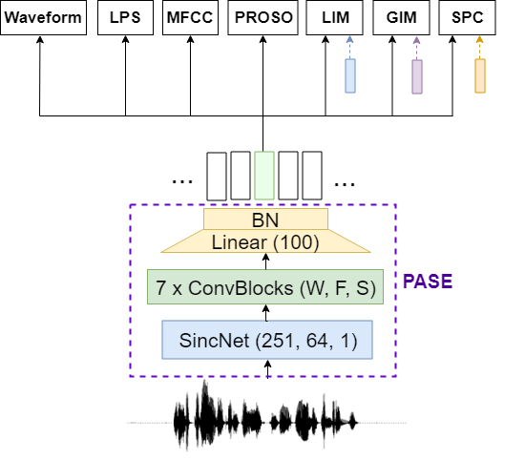
Problem-Agnostic Speech Encoder (PASE)
Idea: jointly tackle multiple self-supervised tasks
Encoder:
Transforms raw samples into a higher-level representation.
Workers:
They are small neural networks that solve different pretext tasks.
Regression Tasks:
Learning known speech representations.
Discriminative Tasks:
Learning high-level features by using contrastive learning with different sampling strategies.
(Ravanelli, 2019)

Slide 39
Problem-Agnostic Speech Encoder (PASE)
Idea: jointly tackle multiple self-supervised tasks
Regression Tasks:
Waveform worker: estimates the original waveform.
LPS worker: we estimate the log-spectrogram.
MFCC worker: we estimate the MFCC features.
Proso worker: we estimate prosody features like pitch.
(Ravanelli, 2019)

Slide 40
Problem-Agnostic Speech Encoder (PASE)
Idea: jointly tackle multiple self-supervised tasks
Discriminative Tasks:
Local Info Max (LIM): Determine if two (short) speech chunks come from the same recording.
Global Info Max (GIM): Determine if two (long) speech chunks come from the same recording.
Sequence Predictive Coding (SPC): Determine if one chunk happens before or after another one.
(Ravanelli, 2019)

Slide 41
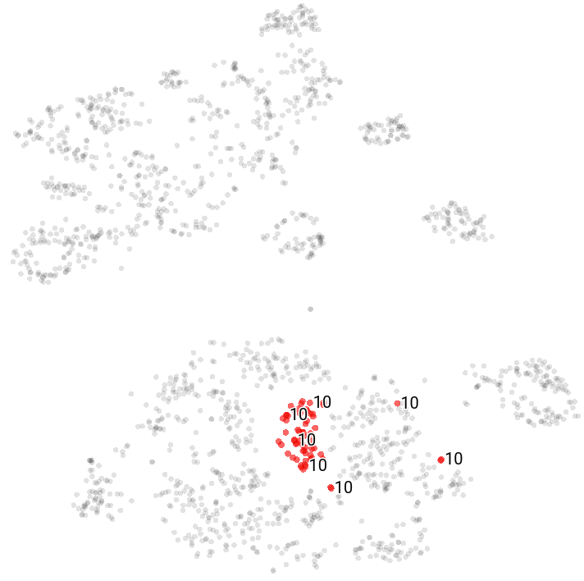
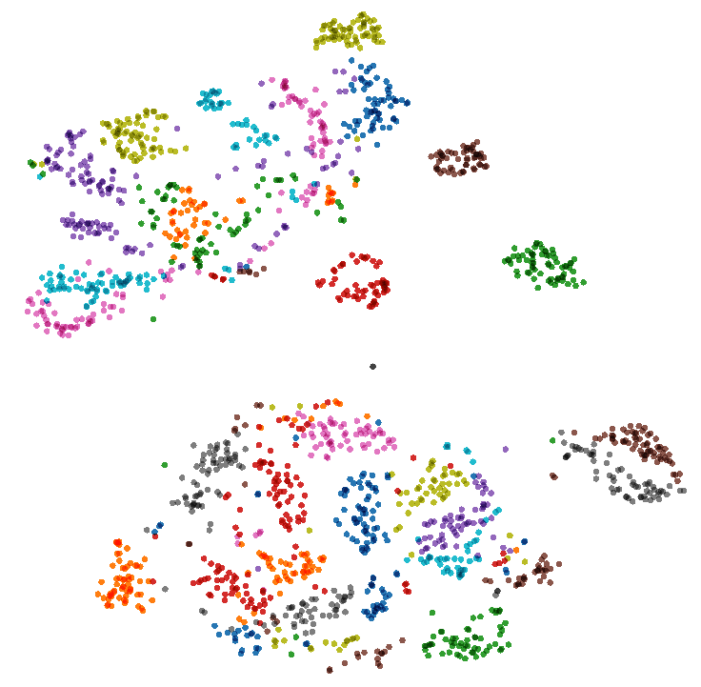
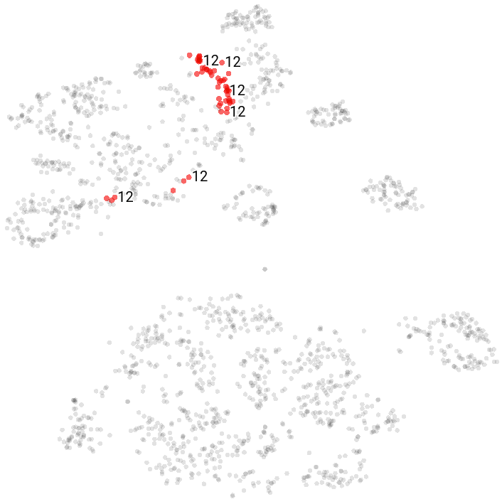
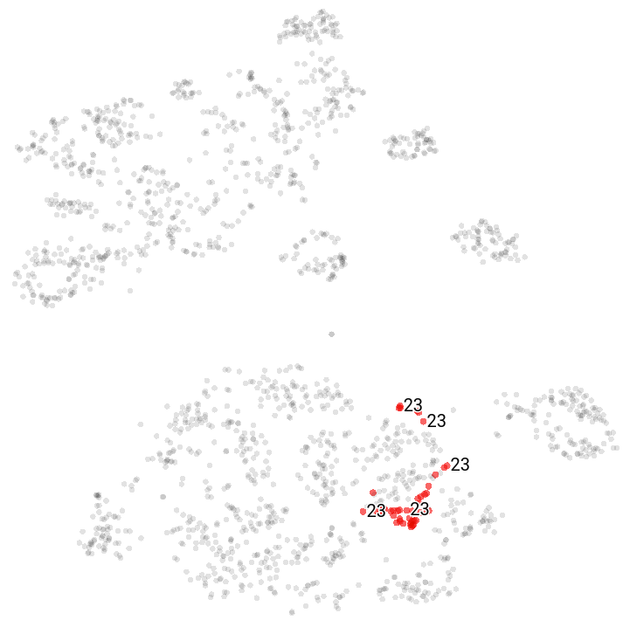
Problem-Agnostic Speech Encoder (PASE)
Speaker identities
S. Pascual, M. Ravanelli, J. Serrà, A. Bonafonte, Y. Bengio " Learning Problem-agnostic Speech Representations from Multiple Self-supervised Tasks“, Proc. of Intespeech 2019.

Slide 42
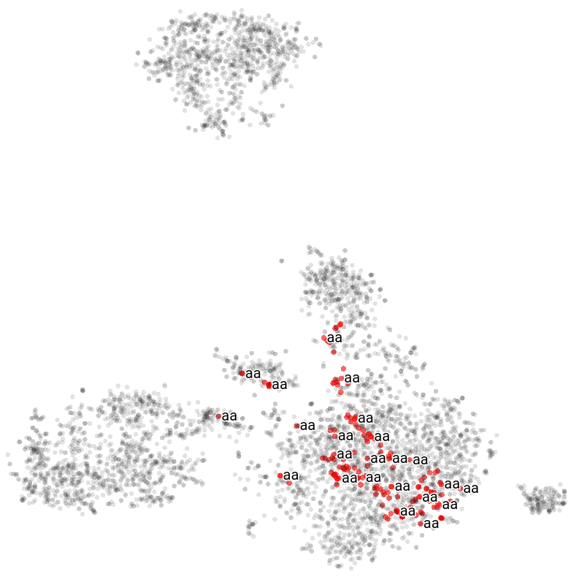
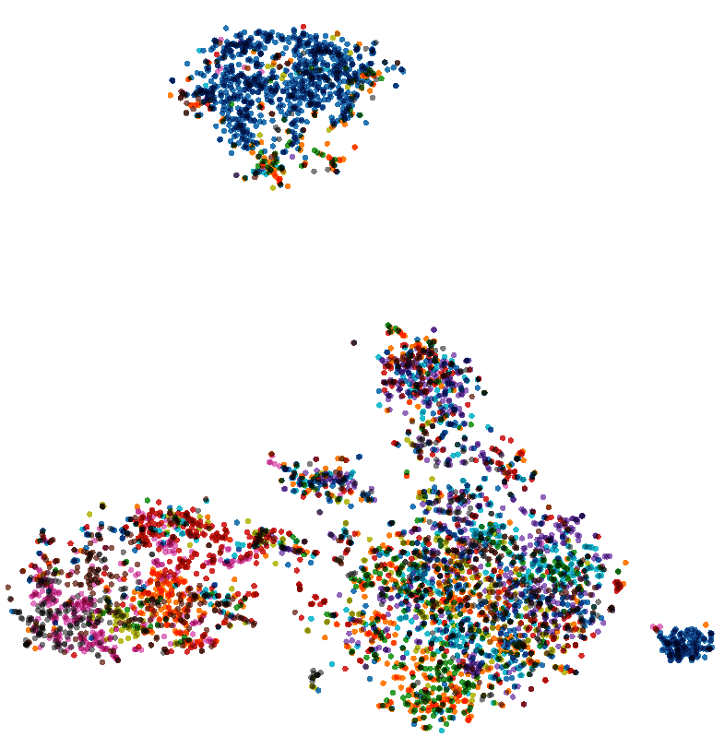
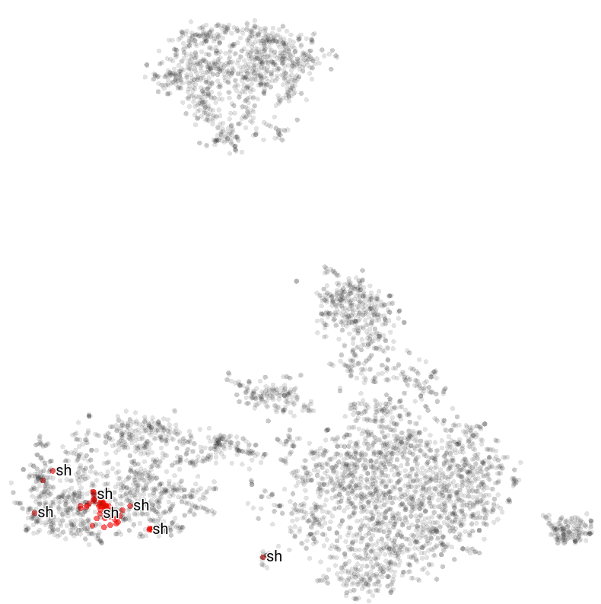
Problem-Agnostic Speech Encoder (PASE)
Phonemes
S. Pascual, M. Ravanelli, J. Serrà, A. Bonafonte, Y. Bengio " Learning Problem-agnostic Speech Representations from Multiple Self-supervised Tasks“, Proc. of Intespeech 2019.

Slide 43
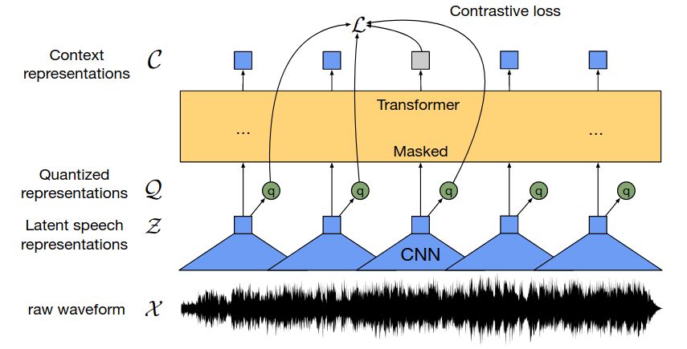
Wav2vec2
Right after PASE, we have assisted in a proliferation of self-supervised models for speech processing.
The most famous one is wav2vec2.
Wav2vec nicely integrates many effective techniques:
Large Transformers
Contrastive Learning
Discrete Representations
Huge unlabelled dataset (54k hours)
(Baevski, 2020)

Slide 44
Wav2vec2
More specifically, wav2vec2 works in this way:
A convolutional encoder converts the raw waveform into latent speech representations z.
The latent speech representations z are fed into a Transformer that estimates higher-level context representations c.
The vector z contains local information.
(Baevski, 2020)
The vector c contains global information.

Slide 45
Wav2vec2
More specifically, wav2vec2 works in this way:
What is the pretext task?
We randomly mask some time-steps in z.
The transformer should figure out the c vector for the missing steps.
Similarly to CTC, we do not reconstruct directly the missing time steps of c.
Instead, we use contrastive learning:
(Baevski, 2020)
The model needs to identify the correct (missing) z among a set of K + 1 candidates (i.e., the right z and K distractors sampled from the same sequence).

Slide 46
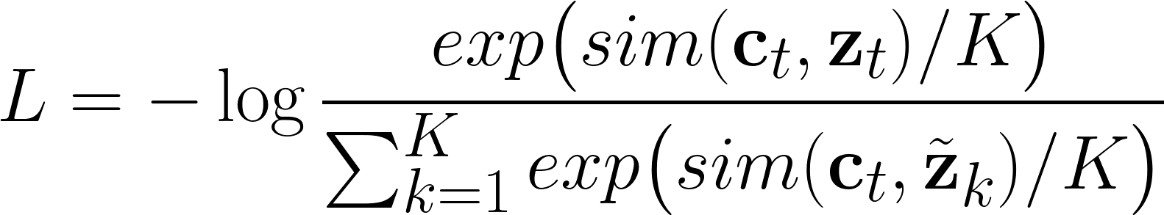
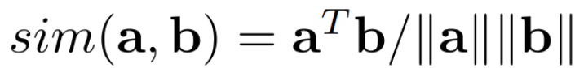
Wav2vec2
More specifically, wav2vec2 works in this way:
What is the pretext task?
Actual value of the masked element
Masked element
Distractors
(Baevski, 2020)
Cosine similarity
Intuition: we want ct to be as close as possible to the right zt.

Slide 47

Wav2vec2
Actually, things are a bit more complex than that…
The model is not trained to identify the correct z, but a quantized version of it called q.
The authors found that to be more effective than using the non-quantized continuous z.
(Baevski, 2020)
On the other hand, discrete representations might capture well discrete categories such as phonemes, speaker identities, language, etc.
Discrete representations can be more robust to noise because small changes to the input data might not cause changes in the output.

Slide 48
Wav2vec2
How to we quantize z?
We use vector quantization to learn G codebooks with V vectors (of dimensionality d) in each one:
……..
V
d
G Codebooks
We choose one entry from each codebook, concatenate the resulting vectors, and apply a linear transformation to get q.
d
d
d
f
Linear
G selected vectors
q

Slide 49
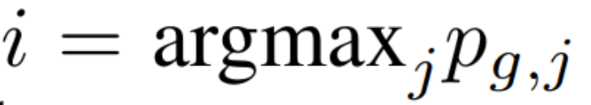
Wav2vec2
How do we select the G codebook vectors needed to get q?
We apply G linear transformations such that z is mapped into a GxV dimensional space.
……..
V
Linear
G
z
G Codebooks
V
2. Then, we apply the softmax to turn it into a set of probabilities pg,j
3. For each codebook, select the vector with the highest probability:
Logits
Probabilities
G
Softmax
G
pg,j
Do you see issues here?
V
V

Slide 50
Wav2vec2
The argmax operation is not differentiable!
The argmax function returns the index of the maximum element in a given vector.
Small changes in the input values can result in no changes in the output index (or a big change).
The argmax operation is not continuous or smooth, which are the properties required for a function to be differentiable.
This is a problem at training time as we cannot compute the gradient (at inference time, it is not a problem).
What can we do?

Slide 51
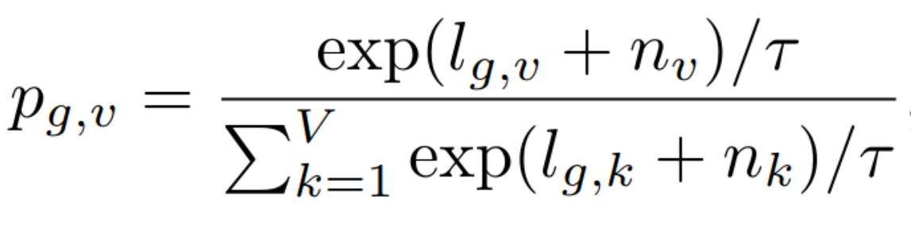
Wav2vec2
Different approaches have been explored in the literature to circumvent this issue.
Wav2vect uses the Gumbel softmax.
It is a differentiable approximation of the argmax:
τ is the temperature hyperparameter (A low temperature makes the model more confident. A high temperature makes the model less confident).
n is the noise (used to add stochasticity).

Slide 52
Wav2vec2
Gumbel softmax:
In the forward step, we simply pick up the vector corresponding to the highest probability:
0.1
0.4
0.0
0.2
0.3
0.0
argmax
In the backward step, the gradient of the Gumbel softmax outputs is used.

Slide 53
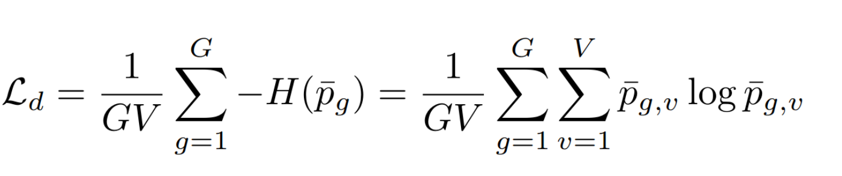
Wav2vec2
At training time, we want to encourage the model to use all the elements in the codebook (and not collapse and use only some of them).
Logits
Logits
0.1 0.1 0.8 0.0 0.1
0.9 0.0 0.1 0.0 0.0
Ideally, we want all the vectors in the codebook to be picked up with the same frequency.
Batch
0.1 0.0 0.9 0.0 0.0
Batch
0.2 0.1 0.2 0.1 0.4
0.0 0.0 1.0 0.0 0.0
0.3 0.1 0.5 0.1 0.1
V
V
To promote diversity, wav2vec2 introduces a diversity loss:
The goal is to maximize the entropy of the averaged softmax distribution over the codebook entries across a batch of utterances

Slide 54
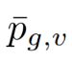
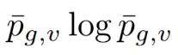
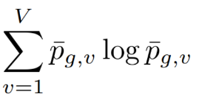
Wav2vec2
Goal: promote diversity.
V
V
0.1 0.1 0.8 0.0 0.1
0.9 0.0 0.1 0.0 0.0
Batch
0.1 0.0 0.9 0.0 0.0
Batch
0.2 0.1 0.2 0.1 0.4
0.0 0.0 0.9 0.1 0.0
0.3 0.0 0.5 0.1 0.1
0.066
0.033
0.866
0.033
0.033
0.466
0.033
0.266
0.066
0.166
-0.1793
-0.1125
-0.1245
-0.1125
-0.1125
-0.355
-0.1125
-0.3522
-0.2980
-0.1125
This solution is better because it has a lower loss
-0.6413
-1.23

Slide 55


Wav2vec2
The total loss is the sum of two contributions:
Contrastive Loss:
Promotes learning good representations with contrastive learning.
Diversity Loss:
Promotes diversity in the vectors selected from the codebooks.

Slide 56
Wav2vec2
After training the model on a large dataset of unlabeled speech recordings, we plug a classifier on top of it.
Classifier
prediction
The classifier solves one downstream task such as speech recognition, speaker recognition, emotion recognition, and any other speech processing task.
pretrained
The classifier and the pre-trained wav2ve models are often jointly fine-tuned using a small labeled dataset.

Slide 57



Wav2vec2
When trained on a huge unlabeled dataset (i.e., 52.3k hours of speech), wav2vec achieves impressive performance on several tasks, in particular on speech recognition:
Librispeech
Word Error Rate on Librispeech (test-clean): 1.8% (using 960 hours of annotated data for fine tuning)
Word Error Rate on Librispeech (test-clean): 4.8% (using 10 minutes of annotated data for fine tuning)
TIMIT

Slide 58



Hubert
An alternative to wav2vec2 is Hidden-Unit BERT (HuBERT):
Similarly to wav2vec2, HuBERT employs a CNN encoder followed by a masked Transformer.
Before training, we run a k-mean clustering on top of FBANK or MFCC features.
Hsu (2021)
The goal is to provide some noisy labels that hopefully correspond to some pseudo-acoustic units.
After few a more training epochs, we can run clustering again on top of the learned features (instead of MFCCs).

Slide 59

WavLM
WavLM is similar to Hubert, with the following improvements:
It performs data augmentation to the input signal by adding noise or other disturbances.
They improved the attention mechanism with a gated relative position bias.
It is trained with more data (from 60k hours to 94k hours).
Chen (2022)

Slide 60


SUPERB Benchmark
SUPERB is a largely adopted benchmark to evaluate self-supervised models.
It defines a bunch of downstream tasks (speech recognition, speaker recognition, emotion recognition, keyword spotting, intent classification, …) used to evaluate self-supervised features.
WavLM is currently the state-of-the-art
https://superbbenchmark.org

Slide 61


SSL Benchmark
https://github.com/speechbrain/benchmarks/tree/main/benchmarks/MP3S

Slide 62
Discrete Audio Representations
Recent Research Trend: Learning Discrete Audio Representations rather than continuous ones.
Continuous Representations
Discrete Representations
At each time step, our model outputs a vector of real numbers.
At each time step, our model outputs a vector from the codebook.
SSL Model
SSL Model
Codebook

Slide 63

Discrete Audio Representations
We assign a different integer to each vector in the codebook.
1
0
3
3
4
2
The models output a sequence of integers
Where can this be helpful?
SSL Model
0
1
2
3
4
Codebook

Slide 64





Discrete Audio Representations
Discrete audio tokens can be helpful for:
Efficient data storage and transmission.
We close the gap between audio processing and NLP!
+
Audio Language Models (e.g., AudioLM)
MultiModal Language Models (e.g., Gemini)
Discrete tokens simplify audio generation tasks like speech enhancement and synthesis, using classification methods instead of complex regression models.

Slide 65
Discrete Audio Representations
What's the primary issue?
The main issue is the loss of information due to the discretization process.
However, recent studies shown that discrete audio tokens excel in numerous tasks like ASR, TTS, and Enhancement.

Slide 66

Discrete Audio Representations
In the current literature, we can find two types of audio tokens:
Compression Tokens (Codecs)
Semantic Tokens
Discrete Tokens
Decoder
Discrete Tokens
K-Means Clustering
Vector Quantizer
SSL Model
Wav2vec, Huber, WavLM
Encoder

Slide 67
References
[1] Dimitri Palaz, Mathew Magimai-Doss, Ronan Collobert , "Analysis of CNN-based Speech Recognition System using Raw Speech as Input", Paper
[2] Mirco Ravanelli, Yoshua Bengio, "Speaker Recognition from Raw Waveform with SincNet", Paper
[3] Aaron van den Oord, Yazhe Li, Oriol Vinyals, "Representation Learning with Contrastive Predictive Coding", Paper
[4] Mirco Ravanelli, Yoshua Bengio, "Learning Speaker Representations with Mutual Information", Paper
[5] Santiago Pascual, Mirco Ravanelli, Joan Serrà, Antonio Bonafonte, Yoshua Bengio, "Learning Problem-agnostic Speech Representations from Multiple
Self-supervised Tasks", Paper
[6] Mirco Ravanelli, Jianyuan Zhong, Santiago Pascual, Pawel Swietojanski, Joao Monteiro, Jan Trmal, Yoshua Bengio, "Multi-task self-supervised learning for Robust Speech Recognition", Paper
[7] Alexei Baevski, Henry Zhou, Abdelrahman Mohamed, Michael Auli, ”wav2vec 2.0: A Framework for Self-Supervised Learning of Speech Representations”, Paper
[8] Wei-Ning Hsu, Benjamin Bolte, Yao-Hung Hubert Tsai, Kushal Lakhotia, Ruslan Salakhutdinov, Abdelrahman Mohamed, "HuBERT: Self-Supervised Speech Representation Learning by Masked Prediction of Hidden Units", Paper
[9] Sanyuan Chen, Chengyi Wang, Zhengyang Chen, Yu Wu, Shujie Liu, Zhuo Chen, Jinyu Li, Naoyuki Kanda, Takuya Yoshioka, Xiong Xiao, Jian Wu, Long Zhou, Shuo Ren, Yanmin Qian, Yao Qian, Jian Wu, Michael Zeng, Xiangzhan Yu, Furu Wei, "WavLM: Large-Scale Self-Supervised Pre-Training for Full Stack Speech Processing", Paper
[10] Shu-wen Yang et al., “SUPERB: Speech processing Universal PERformance Benchmark”, Paper

Slide 68
References
Recent Literature on Audio Tokens
[11] N. Zeghidour, A. Luebs, A. Omran, J. Skoglund, and M. Tagliasacchi, “Soundstream: An end-to-end neural audio codec,” IEEE/ACM Transactions on Audio, Speech, and Language Processing, vol. 30, pp. 495–507, 2021. [paper]
[12] A. D ́efossez, J. Copet, G. Synnaeve, and Y. Adi, “High fidelity neural audio compression,” arXiv preprint arXiv:2210.13438, 2022. [paper]
[13] R. Kumar, P. Seetharaman, A. Luebs, I. Kumar, and K. Kumar, “High-fidelity audio compression with improved rvqgan,” Proc. of NeurIPS, 2023. [paper]
[14] D. Yang, S. Liu, R. Huang, J. Tian, C. Weng, and Y. Zou, “Hifi-codec: Group-residual vector quantization for high fidelity audio codec,” arXiv preprint arXiv:2305.02765, 2023. [paper]
[15] A. Polyak, Y. Adi, J. Copet, E. Kharitonov, K. Lakhotia, W.-N.Hsu, A. Mohamed, and E. Dupoux, “Speech Resynthesis from Discrete Disentangled Self-Supervised Representations,” in Proc.Interspeech, 2021. [paper]
[16] Y.-A. Chung, Y. Zhang, W. Han, C.-C. Chiu, J. Qin, R. Pang, and Y. Wu, “W2v-bert: Combining contrastive learning and masked
language modeling for self-supervised speech pre-training,” in Proc. of ASRU, 2021. [paper]

Slide 69


Lab Session
During the weekly lab session, we will do:
Emotion Recognition (with self-supervised models)
Native vs Non-Native Classification (with self-supervised models)
Deadline: March, 19 11.59 pm

